Slide 2
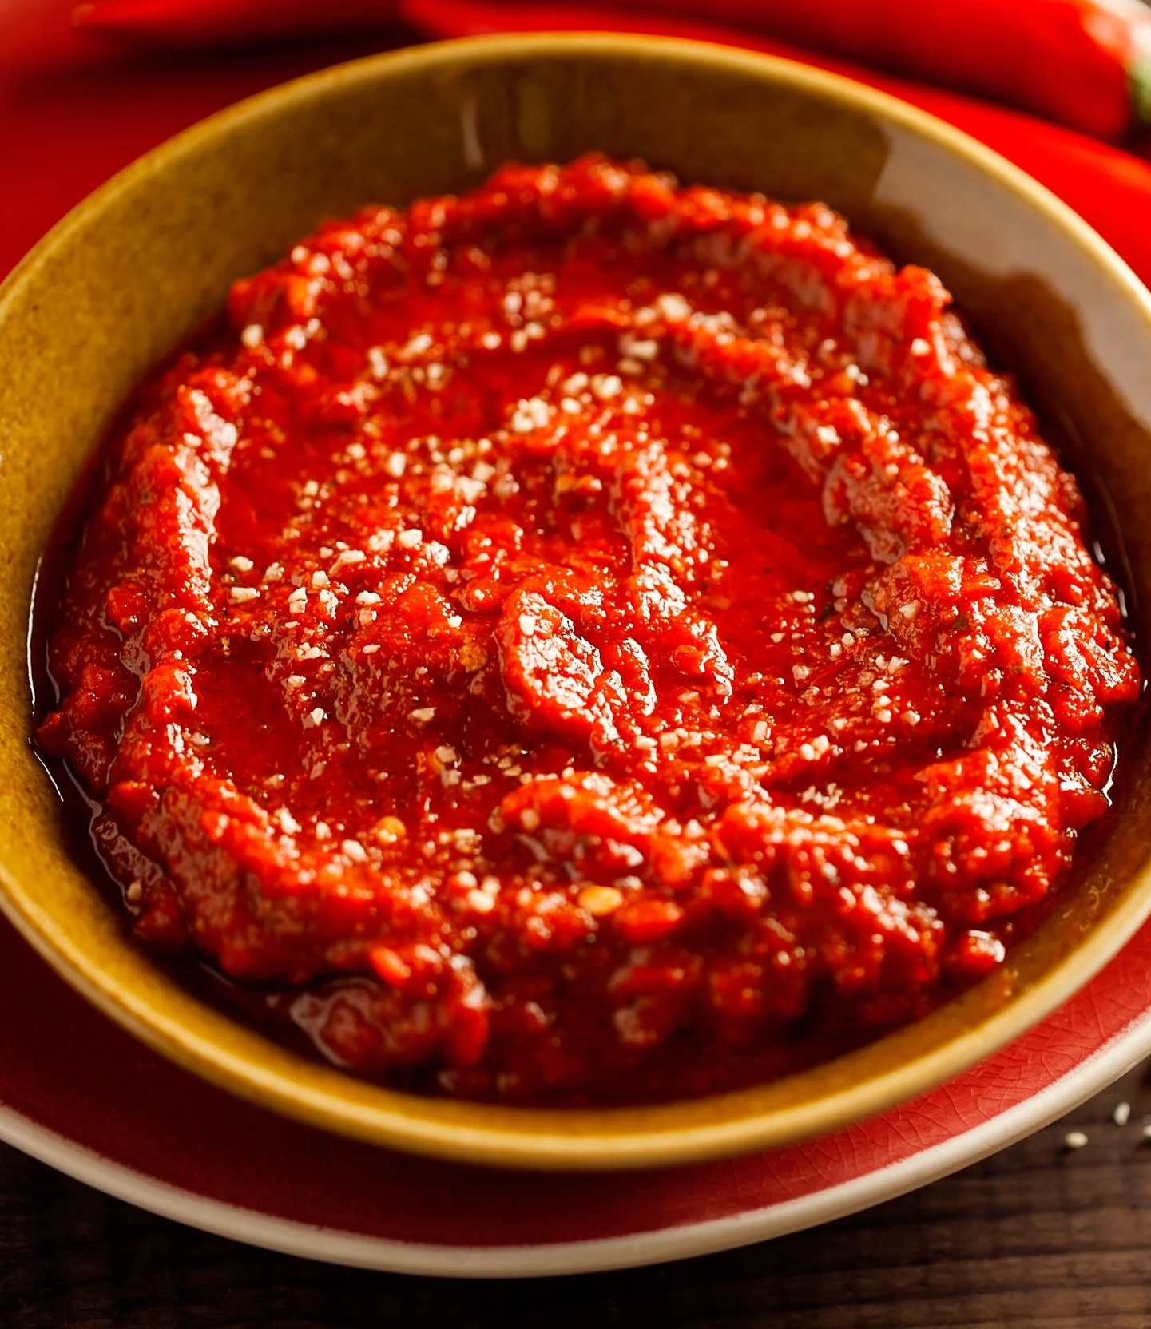
ALL ABOUT HARISSA
Harissa is a chili-based paste that originates from the Maghreb region of North Africa, with the strongest cultural ties to Tunisia, where it is considered a national condiment. Its history traces back to the 16th century, when chili peppers were introduced to the region from the Americas following Spanish and Portuguese exploration.
Tunisian cooks began blending these peppers with local spices, garlic, and olive oil, creating a distinctive paste that reflected both indigenous North African culinary traditions and the influence of global trade. Over centuries, harissa spread throughout Algeria, Morocco, and into parts of the Middle East, adapting slightly to local spice profiles while retaining its signature chili-forward character. Families take pride in their own recipes, which are often passed down through generations, with subtle differences in spice ratios or preparation methods.
Traditional harissa is made through a careful process that balances heat, aroma, and depth of flavor. Sun-dried or fresh red chilies form the foundation, often rehydrated and then ground with a mortar and pestle or, in modern settings, with mechanical grinders. Garlic, salt, and spices such as coriander, cumin, and caraway are incorporated, followed by a generous amount of olive oil, which both binds and preserves the paste. While commercial production now often uses industrial grinding and mixing equipment, artisanal producers in Tunisia and beyond still rely on hand-processing techniques, which they believe yield a more complex and aromatic result.
Through migration, trade, and the international popularity of North African cuisine, harissa has moved well beyond its original borders. It is now produced and enjoyed worldwide, from artisanal small-batch jars in European delicatessens to mass-market tubes in American grocery stores. Despite this globalization, the heart of harissa remains in the Maghreb, where it continues to serve as both a daily staple and a cultural emblem. In 2022, UNESCO added Tunisian harissa to its list of Intangible Cultural Heritage of Humanity, recognizing it as a living tradition that encompasses agricultural practices, food preservation techniques, and communal sharing.
ACF IOTM
SEPTEMBER 2025
HARISSA

Slide 3
HEALTHY INGREDIENT CONTRIBUTION
Harissa’s nutritional profile varies by brand and recipe with some blends are richer in oil, while others are more pepper-forward. Though not a major source of nutrients in large quantities, it stands out as a flavorful, nutrient-dense condiment. In moderation, harissa enhances vitamin intake, delivers metabolism- and heart-supporting compounds, and adds vibrant, healthful spice to dishes.
Nutritional Profile (approx. 2 tablespoons):
Vitamin C — 34% DV: Boosts immunity, aids collagen production, and acts as an antioxidant
Iron — 6% DV: Essential for oxygen transport in blood and energy production
Vitamin B6 — 6% DV: Helps convert food into energy and supports brain health
Vitamin A — 5% DV: Supports vision, skin health, and immune function
Fiber — 2% DV: Promotes healthy digestion and supports heart health
Calcium — 1% DV: Strengthens bones and teeth, supports muscle and nerve function
Potassium — 1% DV: Helps regulate fluid balance, supports muscle health, and maintains healthy blood pressure
Nutritional Information/Values from USDA FoodData Central
ACF IOTM
SEPTEMBER 2025
HARISSA

Slide 4
TYPES AND VARIETIES
Harissa isn’t just one paste with a one-note flavor. It has many regional styles and variations, influenced by local peppers, spices, and traditions. Here’s a breakdown:
By Texture & Form:
Traditional Paste – Thick chili paste made with peppers, garlic, olive oil, and spices; most common.
Powdered Harissa – Dried spice blend version; rehydrated with oil/water or sprinkled as seasoning.
Sauce / Condiment Form – Thinner, bottled version (similar to hot sauce) for easy pouring.
By Heat Level:
Mild Harissa – Uses sweeter, milder chilies (like roasted red peppers); more smoky than hot.
Medium/Classic – Balanced heat from North African chilies, garlic, and spices; versatile everyday version.
Extra Hot – Made with fiery peppers like bird’s eye or cayenne; intense and pungent.
By Regional Style:
Tunisian – Bold and fiery, often with caraway, cumin, and coriander
Moroccan – More aromatic and complex, often includes preserved lemon or rose petals
Algerian – Earthier with strong cumin and caraway notes, often used as both a condiment and cooking base
Libyan – Typically very spicy and chili-forward, often served alongside bread, meats, or couscous
By Flavor Addition / Modern Twists:
Smoked Harissa – Uses smoked chilies for depth and complexity.
Herbed Harissa – Includes mint, parsley, or cilantro for freshness.
Citrus Harissa – Infused with lemon or orange zest for brightness.
Sweet Harissa – Balances heat with roasted bell peppers, tomatoes, or even a touch of honey.
ACF IOTM
SEPTEMBER 2025
HARISSA

Slide 5
SELECTING AND STORING
Selecting Harissa:
Check the Ingredients – Look for simple, traditional components such as chilies, garlic, olive oil, and spices including cumin, coriander, caraway. Avoid brands with excessive preservatives or added sugar.
Heat Preference – Choose based on your spice tolerance: mild (more bell pepper-based), medium/classic, or extra hot.
Form – Pastes in jars or tubes are classic and versatile; powdered has a long shelf life and works well for rubs and marinades; and sauce form is thinner and ready to drizzle
Regional Style – Tunisian (fiery, robust), Moroccan (aromatic, sometimes floral), Algerian (earthy), or specialty versions (smoked, herbed, citrus)
Quality Signals – Rich red color, aromatic fragrance, and balance of spice without bitterness.
Storing Harissa:
Unopened Jars/Tubes – Store in a cool, dry place such as a pantry or cabinet.
After Opening – Refrigerate and keep covered with a thin layer of olive oil to prevent drying or mold.
Powdered Harissa – Store in an airtight container in a cool, dark place; lasts 6–12 months
ACF IOTM
SEPTEMBER 2025
HARISSA

Slide 6
CULINARY USES
Harissa is incredibly versatile as it can be used as a marinade, seasoning, sauce base, or finishing condiment that adds both heat and complexity. Here are a few ideas to add to your kitchen repertoire:
Marinades – Mix with olive oil and lemon for chicken, lamb, beef, or seafood.
Sauces & Dressings – Stir into yogurt, mayo, or tahini for dips, spreads, and salad dressings.
Soups & Stews – Add a spoonful to broths, lentil stews, or tagines for depth and heat.
Pasta & Noodles – Stir into tomato sauces, creamy sauces, or oil-based dressings for a spicy twist.
Grains & Vegetables – Toss with couscous, quinoa, roasted potatoes, carrots, or cauliflower.
Sandwiches & Wraps – Spread inside pita, flatbreads, or sandwiches for a spicy kick.
Pizza & Flatbreads – Drizzle on top before or after baking for heat and flavor.
Roasted Nuts & Snacks – Toss nuts or chickpeas with harissa and roast for a spicy snack.
Eggs – Swirl into scrambled eggs, shakshuka, or omelets.
Seafood – Mix into butter or oil for grilled fish, shrimp, or scallops.
Condiment – Use as a table sauce alongside bread, grilled meats, or mezze platters.
ACF IOTM
SEPTEMBER 2025
HARISSA

Slide 7
INTERESTING FACTS
Harissa comes from the Arabic word harasa, meaning “to pound” or “to crush,” referring to the traditional method of making it in a mortar.
Traditional harissa made in Tunisia uses Baklouti peppers which moderately range from 1,000 to 5,000 on the Scoville heat unit scale.
Canned or jarred harissa has made it easy for North African immigrants to spread their cuisine globally, making it one of the first “international” hot sauces.
In Tunisia, there are chili festivals celebrating harissa and local peppers, including competitions for the spiciest paste.
In 2022, UNESCO recognized harissa as part of Tunisia's Intangible Cultural Heritage, underscoring its importance in Tunisian culinary traditions.
Tunisia produces an average of 31,000 tons of harissa per year, using over 60,000 tons of fresh peppers annually.
As of 2024, the global harissa market was valued at approximately USD 713 million with estimates to reach USD 1.25 billion by 2033.
Modern chefs use harissa in ice cream, cocktails, and even chocolate truffles, demonstrating its versatility beyond savory dishes.
ACF IOTM
SEPTEMBER 2025
HARISSA

Slide 8
RECIPE
Harissa Honey Chicken
Yield: 6 Servings
Ingredients:
3-4 Tbsp Harissa Paste
2 Tbsp Tomato Paste
¼ Cup Honey
1 Lemon, Juiced
¼ Cup Olive Oil
1 Tsp Aleppo Pepper Flakes
1 Tsp Coriander
½ Tsp Smoked Paprika
5 Cloves Garlic, Minced
8 Chicken Thighs, Bone-in, Skin-on
Directions:
Preheat the oven to 375 degrees F.
In a small bowl, combine all ingredients except for the chicken thighs. Stir well to combine.
Rub the mixture over each chicken thigh and under the skin, ensuring each thigh is coated evenly. Place chicken thighs skin-side up on a sheet pan.
Bake in the oven until the chicken is cooked through and the skin is browned and caramelized, about 35 to 40 minutes. An instant-read thermometer inserted into thickest part of thigh, near the bone, should read 165 degrees F.
Pair with your desired starch and vegetable components and drizzle with pan sauce before serving.
ACF IOTM
SEPTEMBER 2025
HARISSA

Slide 9
QUIZ
After you read through this month’s Ingredient of the Month, take this quiz to test your knowledge. In order to earn continuing education hours (CEHs) from the American Culinary Federation (ACF), the test must be completed through the ACF’s Online Learning Center. Seventy-five percent accuracy is required to earn one hour of continuing education credits toward professional certification.
ACF IOTM
SEPTEMBER 2025
HARISSA

Slide 10
QUIZ
Question #1
Which country is said to have the strongest cultural ties to harissa?
Morocco
Tunisia
Algeria
Egypt
ACF IOTM
SEPTEMBER 2025
HARISSA

Slide 11
QUIZ
Question #2
Which spices are commonly used in harissa?
Cinnamon, nutmeg, and cloves
Paprika, oregano, and thyme
Saffron, turmeric, and fenugreek
Coriander, cumin, and caraway
ACF IOTM
SEPTEMBER 2025
HARISSA

Slide 12
QUIZ
Question #3
What percentage of the daily value (DV) for Vitamin C does two tablespoons of harissa provide?
5%
6%
34%
43%
ACF IOTM
SEPTEMBER 2025
HARISSA

Slide 13
QUIZ
Question #4
Which nutrient in harissa helps maintain healthy blood pressure and muscle health?
Calcium
Iron
Vitamin B6
Potassium
ACF IOTM
SEPTEMBER 2025
HARISSA

Slide 14
QUIZ
Question #5
Moroccan harissa is known for its bold and fiery flavor with a heavy use of caraway.
True
False
ACF IOTM
SEPTEMBER 2025
HARISSA

Slide 15
QUIZ
Question #6
Which harissa form has the longest shelf life and works well for rubs and marinades?
Paste Form
Powdered Form
Sauce Form
Frozen Form
ACF IOTM
SEPTEMBER 2025
HARISSA

Slide 16
QUIZ
Question #7
Harissa is versatile enough to be used both during cooking and after cooking as a finishing condiment.
True
False
ACF IOTM
SEPTEMBER 2025
HARISSA

Slide 17
QUIZ
Question #8
What does the Arabic word harasa, from which “harissa” is derived, mean?
To boil or stew
To pound or crush
To mix or blend
To dry or smoke
ACF IOTM
SEPTEMBER 2025
HARISSA

Slide 18
QUIZ
Question #9
What is the Scoville heat range for Baklouti peppers used in traditional Tunisian harissa?
100-500 SHU
1,000-5,000 SHU
5,000-10,000 SHU
50,000-100,000 SHU
ACF IOTM
SEPTEMBER 2025
HARISSA

Slide 19
QUIZ
Question #10
What internal temperature should the harissa honey chicken thighs reach when fully cooked?
145°F
155°F
165°F
185°F
ACF IOTM
SEPTEMBER 2025
HARISSA

Slide 20
JOIN US NEXT MONTH!
Stay tuned for the next ACF Ingredient of the Month! Be sure to visit the Online Learning Center (OLC) to download a copy of each month’s ingredient presentation. Don’t forget to take the official IOTM quiz through the OLC to earn one hour of continuing education credits toward professional certification.
For more information:
www.acfchefs.org
www.acfchefs.org/olc
www.acfchefs.org/iotm
ACF IOTM
SEPTEMBER 2025
HARISSA

