Slide 2
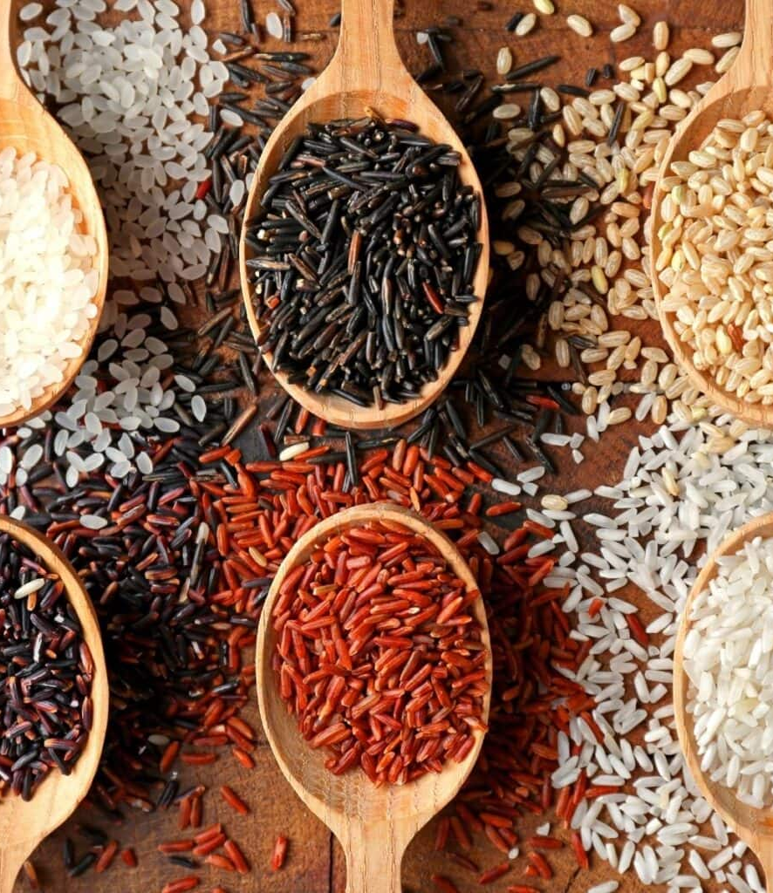
ALL ABOUT RICE
The history of rice is a long and fascinating journey that spans thousands of years and multiple cultures. Rice is a staple food for a significant portion of the world's population. Roughly fifty-percent of the world population, including almost all of East and Southeast Asia, is wholly dependent upon rice.
The cultivated rice plant (Oryza sativa) is an annual grass that grows to about 4 feet in height. The leaves are long and flattened and the plant has a fibrous, broad root system. The panicle, or flower cluster, is made up of spikelet bearing flowers that produce the grain.
More than 90 percent of the world’s rice is grown in Asia, mainly China, India, Indonesia, and Bangladesh, with smaller amounts grown in Japan, Pakistan and other Southeast Asian countries. Rice is also cultivated in Europe, North and South America, and Australia.
Other than a variety called upland rice, the rice plant is grown on submerged land in coastal plains, tidal deltas, and river basins of tropical and temperate regions. The seeds are sown into beds and after 25-50 days and then are transplanted to a field or paddy submerged in 2 to 4 inches of water where it will remain for the growing season.
Successful rice production depends on quality soil, adequate irrigation and long periods of sunshine. Rice production yields can vary greatly but usually range from 600-3500 pounds per acre. Once harvested, the rice is milled to remove the hull and bran layers. Brown rice removes just the hull whereas white rice is milled to remove both the hull and bran. A coating of glucose and talc is sometimes applied to give the kernel a glossy finish before packaging.
ACF IOTM
SEPTEMBER 2023
RICE

Slide 3
HEALTHY INGREDIENT CONTRIBUTION
Rice, particularly whole grain varieties, offers several health benefits due to its nutrient content and role in providing energy. However, it's important to note that the health benefits can vary depending on the type of rice consumed and the overall diet. Some of the potential health benefits include:
Energy Source: Rice is a rich source of carbohydrates, which are the body's primary source of energy. It provides a quick and sustained energy release, making it an important part of a balanced diet, especially for individuals with high energy requirements, like athletes.
Dietary Fiber: Brown rice and other whole grain rice varieties contain dietary fiber, which aids in digestion, helps maintain healthy cholesterol levels, and supports gut health. Fiber can also contribute to a feeling of fullness, which may help with weight management.
Gluten-Free: Rice is naturally gluten-free, making it an excellent option for individuals with celiac disease or gluten sensitivity.
Nutrient Content: Brown rice retains the bran and germ layers, which contain valuable nutrients such as B vitamins (thiamin, riboflavin, niacin), magnesium, and phosphorus. These nutrients play essential roles in metabolism, nerve function, bone health, and more.
Low in Fat and Sodium: Rice is naturally low in fat and sodium, making it a heart-healthy option. Choosing whole grain varieties and cooking rice without adding excessive amounts of salt or butter can further enhance its health benefits.
Nutritional Information/Values from USDA FoodData Central
ACF IOTM
SEPTEMBER 2023
RICE

Slide 4
TYPES AND VARIETIES
Rice is a staple food that comes in various types and varieties, each with its own unique characteristics, flavors, and uses. The type of rice you choose can greatly impact the texture and taste of your dishes.
Common Types and Varieties:
Long Grain Rice
Basmati—aromatic fragrance, elongated grains
Jasmine—aromatic fragrance, slightly sticky texture
American—less aromatic, fluffy texture
Medium Grain Rice
Arborio—high starch content
Calrose—slightly sticky texture
Short Grain Rice
Japanese—sticky texture, holds together
Bomba—absorbs liquids and flavors
Other Types and Varieties:
Glutinous/Sticky Rice
High starch content
Savory or sweet dishes
Wild Rice
Nutty flavor
Not rice but a grass seed
Black/Forbidden Rice
Nutty flavor, chewy texture
Deep black or purplish
Red Rice
Nutty flavor, chewy texture
Reddish hue
Brown Rice
Bran intact
More nutritious
White Rice
Bran and germ removed
Mild flavor, soft texture
Fragrant Rice
Unique aromas and flavors
ACF IOTM
SEPTEMBER 2023
RICE

Slide 5
SELECTING AND STORING
Selecting and storing rice properly is important to maintain its quality, flavor, and nutritional value.
Selecting Rice:
Variety: Choose the type of rice that best suits your dish. Consider factors like texture, flavor, and aroma.
Quality: Look for rice that is clean, free from foreign particles, and doesn’t have any signs of insect infestation or damage.
Packaging: Opt for rice that is well-packaged and sealed. If buying in bulk, ensure that the containers are airtight and properly sealed.
Date: Check the production or “best by” date on the package to ensure freshness.
Storing Rice:
Cool and Dry Place: Store rice in a cool, dry place away from direct sunlight, moisture, and strong odors.
Airtight Containers: Transfer rice to airtight containers or resealable bags to prevent moisture and pests from getting in. This is especially important for rice that comes in paper bags or less sturdy packaging.
Keep Away from Heat: Avoid storing rice near sources of heat such as the range or oven, as heat can lead to spoilage.
Avoid Freezing: While some rice can be frozen, it’s generally not recommended due to potential changes in flavor and texture.
Use Desiccants: Adding desiccant packets to the rice storage container can help absorb excess moisture and maintain dryness.
Rotate Stock: If you buy rice in large quantities, use the oldest stock first to ensure the rice remains fresh.
Whole Grain Rice: Whole grain varieties like brown and red rice have a higher oil content due to the bran layers. This can lead to quicker spoilage, so it’s important to pay close attention to their storage.
ACF IOTM
SEPTEMBER 2023
RICE

Slide 6
CULINARY USES
Rice is an incredibly versatile, low-cost ingredient with a wide range of culinary uses and is usually consumed with other nutrient-rich foods such as fruits, vegetables, legumes, nuts/seeds, poultry and lean meat. It serves as a staple food in many cultures and can be prepared in various ways to create dishes ranging from savory to sweet.
Long-grain rice, which cooks light and fluffy with the kernels separated, is often used for making pilafs, stuffings, rice salads and jambalaya.
Medium-grain rice is moist and tender and is commonly used for making paella and risotto.
Short-grain rice, with its shorter, rounder kernels, becomes moist and sticky when cooked, making it a great option for rice puddings, desserts, and sushi.
Ground rice, used to make rice flour, is a common ingredient in gluten-free baking, as well as for making rice noodles, rice paper, and other dishes.
Fermented rice can be used to make vinegar and alcoholic beverages including rice wine, sake and soju.
Rice milk, made by pressing rice through a millstream, is commonly used as a dairy substitute for vegan cooking and those avoiding dairy.
ACF IOTM
SEPTEMBER 2023
RICE

Slide 7
FUN FACTS
Rice is one of the oldest cultivated grains, with a history that dates back over 10,000 years.
There are over 40,000 varieties of rice, each with its own unique taste, texture, and color.
In 1971, rice became the first grain to be grown in space when Apollo 14 astronauts carried rice seeds to the moon.
The largest serving of fried rice weighed over 6,000 pounds and was achieved in China in 2014.
In some Asian countries, rice paddies are used as canvases to create intricate artworks using different colored rice plants.
Rice requires a significant amount of water to grow, often leading to the construction of elaborate irrigation systems in rice-growing regions.
The International Rice Research Institute (IRRI) in the Philippines played a crucial role in developing high-yielding rice varieties, leading to the "Green Revolution" and increased food production.
In some parts of ancient Asia, rice was used as a form of currency, and taxes were collected in rice.
ACF IOTM
SEPTEMBER 2023
RICE

Slide 8
RECIPE
Vegetable Biryani Yield: 6 Servings
Ingredients:
3 T. Ghee (or Clarified Butter)
1 Medium Yellow Onion, Diced
1 T. Garlic, Minced
1 T. Ginger, Minced
1 Roma Tomato, Minced
½ C. Water
½ C. Green Peas
1 Carrot, Sliced Thin
2 Russet Potatoes, Peeled & Diced
1 Green Pepper, Sliced
2 Stalks Celery, Sliced
1 C. Cauliflower Florets
2 t. Kosher Salt
¼ t. Cayenne Pepper
½ t. Black Pepper
2 t. Garam Masala
1 t. Coriander
½ t. Turmeric
1 t. Cumin
½ t. Cinnamon
4 C. Vegetable Stock
2 C. Basmati Rice, Rinsed & Drained
Directions:
Add ghee into a large Dutch oven over medium-high heat.
Add the onion and cook until translucent, about 3-4 minutes.
Stir in garlic, ginger, tomato, and water. Bring to a simmer and cook until the water has evaporated, about 10 minutes.
Add in the peas, carrot, potato, green pepper, celery, and cauliflower. Mix well to combine.
Add in the salt, cayenne, black pepper, garam masala, coriander, turmeric, cumin, and cinnamon. Stir well to blend spices.
Add in the vegetable stock and bring to a boil.
Add in the rinsed and drained basmati rice.
Reduce the heat to low and cook covered for 18-20 minutes.
Turn off the heat and let sit, covered, for five minutes before serving.
ACF IOTM
SEPTEMBER 2023
RICE

Slide 9
QUIZ
After you read through this month’s Ingredient of the Month, take this quiz to test your knowledge. In order to earn continuing education hours (CEHs) from the American Culinary Federation (ACF), the test must be completed through the ACF’s Online Learning Center. Seventy-five percent accuracy is required to earn one hour of continuing education credits toward professional certification.
ACF IOTM
SEPTEMBER 2023
RICE

Slide 10
QUIZ
Question #1
More than 90 percent of the world’s rice is grown in Japan and Pakistan.
True
False
ACF IOTM
SEPTEMBER 2023
RICE

Slide 11
QUIZ
Question #2
What is rice sometimes coated with to give it a glossy finish?
Cornstarch and talc
Sucrose and talc
Arrowroot starch and talc
Glucose and talc
ACF IOTM
SEPTEMBER 2023
RICE

Slide 12
QUIZ
Question #3
Rice is a rich source of _____, which are the body’s primary source of energy.
gluten
carbohydrates
fiber
magnesium
ACF IOTM
SEPTEMBER 2023
RICE

Slide 13
QUIZ
Question #4
Which type of rice has a mild flavor, soft texture, and has had both the bran and germ removed?
White
Brown
Red
Black
ACF IOTM
SEPTEMBER 2023
RICE

Slide 14
QUIZ
Question #5
Jasmine rice has a _____ texture and is _____ fragrant than American rice.
slightly sticky; less
fluffy; more
slightly sticky; more
fluffy; less
ACF IOTM
SEPTEMBER 2023
RICE

Slide 15
QUIZ
Question #6
Which type of rice is commonly used to make paella and risotto?
Glutinous
Short-grain
Medium-grain
Long-grain
ACF IOTM
SEPTEMBER 2023
RICE

Slide 16
QUIZ
Question #7
Fermented rice is used to make which of the following?
Kombucha
Soju
Sake
Both B and C
ACF IOTM
SEPTEMBER 2023
RICE

Slide 17
QUIZ
Question #8
Which institute played a crucial role in the development of high-yielding rice varieties, contributing to the “Green Revolution”?
IRRI
NASA
WHO
UNICEF
ACF IOTM
SEPTEMBER 2023
RICE

Slide 18
QUIZ
Question #9
How are rice paddies creatively used in some Asian countries?
As swimming pools
As farms for livestock
To create intricate works of art
For building houses
ACF IOTM
SEPTEMBER 2023
RICE

Slide 19
QUIZ
Question #10
What type of rice is used in the recipe for Vegetable Biryani?
American
Basmati
Bomba
Jasmine
ACF IOTM
SEPTEMBER 2023
RICE

Slide 20
JOIN US NEXT MONTH!
Stay tuned for the next ACF Ingredient of the Month! Be sure to visit the Online Learning Center (OLC) to download a copy of each month’s ingredient presentation. Don’t forget to take the official IOTM quiz through the OLC to earn one hour of continuing education credits toward professional certification.
For more information:
www.acfchefs.org
www.acfchefs.org/olc
www.acfchefs.org/iotm
ACF IOTM
SEPTEMBER 2023
RICE

