Slide 2
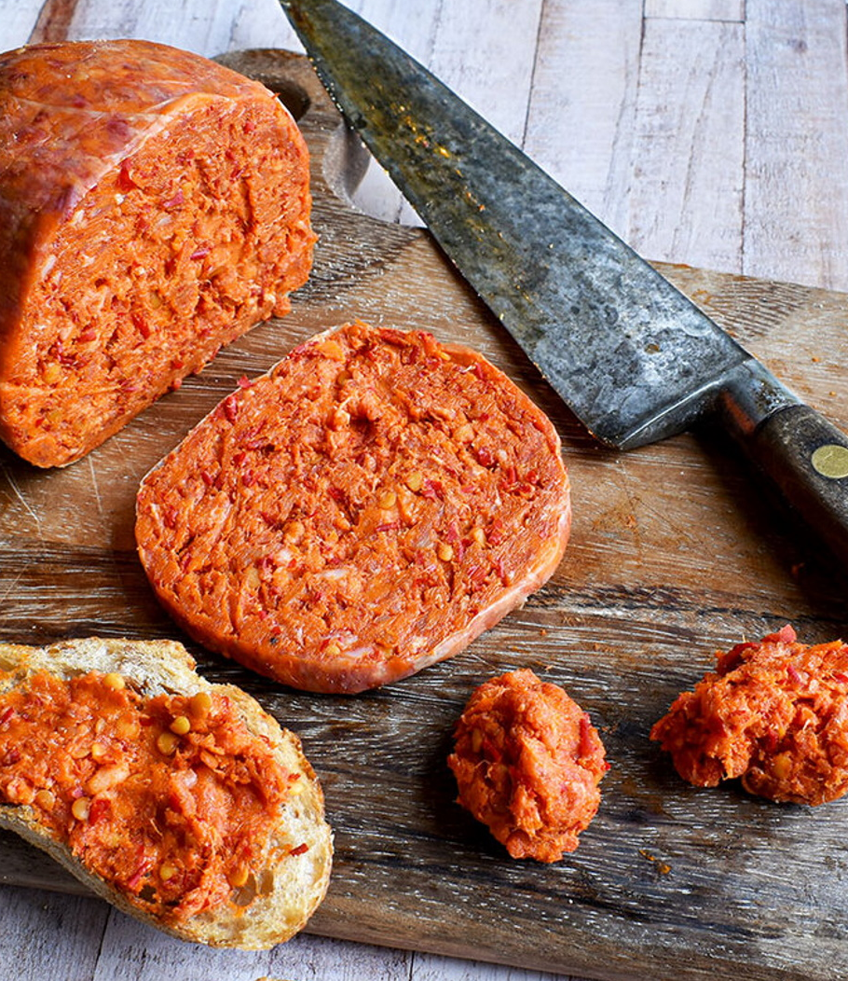
ALL ABOUT ‘NDUJA
Known for its bold heat and rich, creamy texture, ‘nduja (en-DOO-yah) is a pork salami from the Calabria region of Southern Italy. Closely linked to Calabria’s history of resourcefulness and hardship experienced in the early 19th century, ‘nduja is said to have been influenced by France’s andouille sausage introduced in the Napoleonic era. However, unlike andouille, a firm, smoked sausage, 'nduja remains soft, spreadable, and intensely flavorful, setting it apart as a unique staple of Calabrian cuisine.
Historically, 'nduja was considered a "poor man's food", as it was made using less desirable pork cuts such as pork jowl, belly, and shoulder, blended with an abundance of spicy Calabrian chili peppers to preserve the meat and add bold flavor. Over time, this rustic, peasant food became a prized part of Calabrian cuisine, gaining recognition both in Italy and internationally for its versatility in cooking, often used to enhance pastas, pizzas, and even seafood dishes.
Authentic 'nduja is still produced using traditional methods in Calabria. The process starts with selecting pork fat and lean cuts, which are finely ground and mixed with Calabrian chili peppers, giving 'nduja its signature red color and intense heat. The mixture is then stuffed into natural casings, fermented, sometimes lightly smoked, and aged for several weeks to months to develop its deep, complex flavors.
The rise of Italian artisan charcuterie and the growing appreciation for bold, spicy flavors have propelled it into the spotlight, making it a must-try ingredient for food lovers. Whether used traditionally or in modern cuisine, 'nduja remains a symbol of Calabria’s rich culinary heritage.
ACF IOTM
MARCH 2025
‘NDUJA

Slide 3
HEALTHY INGREDIENT CONTRIBUTION
While ‘nduja is often seen as a bold and indulgent treat, it also provides the body with a balance of heart-healthy fats, proteins, gut-friendly probiotics, and antioxidants. Enjoyed in moderation, ‘nduja is a functional food that delivers both flavor and health benefits, making it a versatile and beneficial addition to a balanced [keyword] diet.
Rich in Healthy Fats
Contains monounsaturated fats from pork which can support heart health
Provides omega-3 & omega-6 fatty acids, essential for brain function and reducing inflammation
Helps regulate mood and supports cognitive health
Capsaicin from Chili Peppers
Contains high levels of capsaicin, known for its metabolism-boosting and anti-inflammatory properties
Capsaicin may also help with pain relief and circulation improvement
Supports overall joint and muscle health
High in Protein & Energy
A good source of protein and amino acids, essential for muscle growth and repair
Provides energy-dense nutrition, making it a great diet addition for active individuals
Offers long-lasting satiety, helping curb cravings and maintaining energy levels
Natural Fermentation & Probiotics
Traditional ‘nduja is fermented which can contribute to gut health by promoting good bacteria
Balances gut microbiota, enhancing nutrient absorption and boosting immune function
Contains natural enzymes that aid in digestion
Nutrient Rich Spices
Seasoned with ingredients like paprika and garlic which have antioxidant and immune-boosting benefits
Garlic contains allicin, known for antibacterial and heart-protective effects
Supports overall vitality and disease prevention
Nutritional Information/Values from USDA FoodData Central
ACF IOTM
MARCH 2025
‘NDUJA

Slide 4
TYPES AND VARIETIES
While traditional ‘nduja follows a simple recipe of pork, Calabrian chili peppers, and salt, there are a few varieties and regional adaptations:
Classic Calabrian ‘Nduja – Made from high-fat cuts like pork belly and jowl, blended with fiery Calabrian chilies and aged to develop its deep, smoky heat.
Spilinga ‘Nduja DOP – A protected designation of origin (DOP) variety from Spilinga, ensuring traditional methods and ingredients are used.
Sila ‘Nduja – A mountain-region variation with a slightly firmer texture and a smokier taste due to the cooler curing conditions.
Aspromonte ‘Nduja – Produced in the mountainous Aspromonte area, often featuring a more intense chili kick.
Artisanal ‘Nduja – Crafted by small producers using heritage pork and varying spice levels, sometimes with added smoked paprika or wine for extra complexity.
Smoked ‘Nduja – A less common variety that incorporates additional smoking during the curing process, enhancing its depth of flavor.
Jarred or Tubed ‘Nduja – More convenient versions packaged for easy spreading, often found in gourmet stores and used for quick cooking applications.
‘Nduja-Inspired Variations – Some chefs create modern takes, incorporating ‘nduja into sauces, pâtés, or even plant-based alternatives that mimic its spice and texture.
ACF IOTM
MARCH 2025
‘NDUJA

Slide 5
SELECTING AND STORING
Selecting ‘Nduja:
Origin – Authentic ‘nduja comes from Calabria, especially from Spilinga, where traditional methods are used. Look for DOP-certified varieties for guaranteed authenticity.
Ingredients – High-quality ‘nduja should contain pork, Calabrian chilies, and salt—avoid versions with unnecessary additives or preservatives.
Texture & Appearance – It should be soft, spreadable, and have a deep red color from the chilies. Avoid overly dry or pale ‘nduja, as these may indicate poor quality or improper storage.
Packaging – ‘Nduja is available in natural casings, jars, or tubes. Choose based on convenience and intended use. Vacuum-sealed or well-packaged ‘nduja will have a longer shelf life.
Spice Level – Some varieties are milder or hotter depending on the chili-to-meat ratio. Check labels if you prefer a specific heat intensity.
Storing ‘Nduja:
Room Temperature (Short-Term) – If vacuum-sealed or packed in a jar, ‘nduja can be stored at room temperature (around 60–70°F) in a cool, dry place away from direct sunlight.
Refrigeration (Longer Freshness) – While room temperature is fine, storing ‘nduja in the refrigerator at 35–40°F will prolong its shelf life.
Freezing (Longest Storage) – Portion before freezing, wrap tightly in plastic wrap and foil or an airtight bag, and label with the date for freshness.
How to Tell if ‘Nduja Has Gone Bad:
Color Change – A slight darkening is normal, but grey, green, or black spots indicate spoilage.
Unpleasant Odor – A strong sour, rancid, or rotten smell means it’s no longer safe.
Mold Growth – White mold may appear on natural casing and can be scraped off, but fuzzy or dark mold indicates spoilage.
Texture Change – If ‘nduja becomes excessively dry, crumbly, or slimy, it’s best to discard it.
ACF IOTM
MARCH 2025
‘NDUJA

Slide 6
CULINARY USES
‘Nduja’s rich, spicy, and spreadable texture makes it a versatile ingredient that enhances a wide range of dishes. Here are some of the best ways to use it in cooking:
Eggs & Breakfast Dishes
Scrambled Eggs & Omelets – Stir in for a bold breakfast upgrade.
Eggs in Purgatory – Add to tomato sauce for a fiery shakshuka-style dish.
Spreads & Appetizers
On Bread & Crostini – Simply spread onto toasted bread for a quick and flavorful snack.
With Cheese & Charcuterie – Pairs well with creamy cheeses like burrata, ricotta, or aged pecorino.
Stuffed in Olives or Peppers – Adds a bold kick when used as a filling.
Sauces & Condiments
Butter & Aioli Blends – Mix with butter or mayo for a spicy spread or dip.
Soup & Stew Enhancer – Adds depth to broths, bean soups, and lentil stews.
Pasta & Grains
Pasta Sauce Base – Melt into tomato sauces for a smoky, spicy depth of flavor.
‘Nduja Carbonara – Use it in place of pancetta for a sizzling twist on the classic dish.
Risotto Flavoring – Stir in at the end of cooking to infuse heat and richness.
Pizza & Flatbreads
Pizza Topping – Dollop onto pizza before or after baking for a spicy boost.
Focaccia & Flatbreads – Mix into the dough or spread on top for extra flavor.
Seafood Dishes
With Shellfish and Grilled or Roasted Fish – Complements white fish, shrimp, scallops and mussels.
In Seafood Pasta – Enhances seafood flavors in dishes like spaghetti alle vongole.
Meat & Poultry
Rub for Roasts – Spread onto chicken, pork, or beef before roasting for a smoky crust.
Stuffing Ingredient – Mix into meatballs, sausages, or poultry stuffing.
ACF IOTM
MARCH 2025
‘NDUJA

Slide 7
INTERESTING FACTS
In the past, ‘nduja was stuffed into a pig’s stomach casing and aged for months to develop its complex flavor.
‘Nduja is nicknamed the “Spicy Nutella of Meats” because of its spreadable texture and its composition of two main ingredients.
‘Nduja is also often referred to as “Calabria’s Red Gold” and considered one of Calabria’s greatest culinary treasures.
Spilinga, a small town in southern Italy (Calabria) hosts and annual ‘nduja festival in August of each year.
Up until the early 2000s, ‘nduja was rarely found outside of Italy.
It’s naturally preservative free and requires no refrigeration thanks to the natural antibacterial properties of the Calabrian chili peppers.
Although ‘nduja is cured and ready to eat, it’s flavor greatly intensifies when heated.
Generally speaking, most Italians do not prefer very spicy food, making ‘nduja one of the spiciest foods in their culinary ingredient repertoire.
Calabrian chili peppers often make up to 30% of the sausage!
Some believe ‘nduja to be an aphrodisiac thanks to the combination of chili heat and rich pork fat.
ACF IOTM
MARCH 2025
‘NDUJA

Slide 8
RECIPE
Spicy ‘Nduja Shakshuka Yield: 4 Servings
Shakshuka is a vibrant and aromatic dish that captures the essence of Middle Eastern and North African cuisine. Traditionally presented as a one-pan dish featuring eggs nestled in a rich, spiced tomato and pepper sauce with deep, smoky flavors and just the right touch of heat. Served with crusty bread to scoop up bites directly from the pan, it’s a perfect dish for breakfast, brunch, or cold night.
Ingredients:
2 tbsp. Olive Oil
1 Small Onion, Finely Chopped
2 Cloves Garlic, Minced
1 Red Bell Pepper, Diced
3 tbsp. ‘Nduja
1 Can (15 oz.) Crushed Tomatoes
½ tsp. Smoked Paprika
½ tsp. Cumin
½ tsp. Salt (adjust to taste)
¼ tsp. Black Pepper
¼ tsp. Crushed Red Pepper (adjust to taste)
4 Large Eggs
¼ cup Feta Cheese, Crumbled
Fresh Parsley, Chopped (for garnish)
Crusty Bread (for serving)
Directions:
In a large skillet, heat olive oil over medium heat. Add onion and sauté for 3-4 minutes until softened.
Stir in minced garlic and diced bell pepper, cooking for another 2 minutes.
Add the ‘nduja to the pan and stir until it melts into the oil, releasing its smoky aroma.
Pour in crushed tomatoes, smoked paprika, cumin, salt, black pepper, and chili flakes. Simmer for 10 minutes, stirring occasionally, until the sauce thickens slightly.
Make small wells in the sauce and crack in the eggs. Cover with a lid and cook for 5-7 minutes, until the egg whites are set but the yolks remain runny.
Sprinkle with crumbled feta and fresh herbs. Serve immediately with warm, crusty bread for scooping up the sauce.
ACF IOTM
MARCH 2025
‘NDUJA

Slide 9
QUIZ
After you read through this month’s Ingredient of the Month, take this quiz to test your knowledge. In order to earn continuing education hours (CEHs) from the American Culinary Federation (ACF), the test must be completed through the ACF’s Online Learning Center. Seventy-five percent accuracy is required to earn one hour of continuing education credits toward professional certification.
ACF IOTM
MARCH 2025
‘NDUJA

Slide 10
QUIZ
Question #1
Which Italian region is ‘nduja traditionally from and lends its name to the chili peppers used in its production?
Padrón
Calabria
Pasilla
Anaheim
ACF IOTM
MARCH 2025
‘NDUJA

Slide 11
QUIZ
Question #2
What compound in ‘nduja is known for its metabolism-boosting and anti-inflammatory properties?
Allicin
Omega-6 fatty acid
Monounsaturated fat
Capsaicin
ACF IOTM
MARCH 2025
‘NDUJA

Slide 12
QUIZ
Question #3
The fermentation process in traditional ‘nduja promotes good gut bacteria, enhancing digestion and immune function.
True
False
ACF IOTM
MARCH 2025
‘NDUJA

Slide 13
QUIZ
Question #4
Which ‘nduja variety has a protected designation of origin (DOP) status?
Sila ‘Nduja
Smoked ‘Nduja
Spilinga ‘Nduja
Aspromonte ‘Nduja
ACF IOTM
MARCH 2025
‘NDUJA

Slide 14
QUIZ
Question #5
How does Sila ‘Nduja differ from other varieties?
It has a milder spice level and a creamier texture
It has a firmer texture and a smokier taste
It is aged with added wine for sweetness
It contains no Calabrian chili peppers
ACF IOTM
MARCH 2025
‘NDUJA

Slide 15
QUIZ
Question #6
How should you store ‘nduja for the longest shelf life?
In a jar at room temperature
In the refrigerator at 35–40°F
Wrapped in plastic and foil in the freezer
On the counter, warmed by sunlight
ACF IOTM
MARCH 2025
‘NDUJA

Slide 16
QUIZ
Question #7
What is a sign that ‘nduja has spoiled?
Slight darkening of color
White mold on its natural casing
A strong, sour smell
A soft, spreadable texture
ACF IOTM
MARCH 2025
‘NDUJA

Slide 17
QUIZ
Question #8
‘Nduja is best used cold, as heating it diminishes its flavor.
True
False
ACF IOTM
MARCH 2025
‘NDUJA

Slide 18
QUIZ
Question #9
Traditionally, how was ‘nduja aged to develop its complex flavor?
Wrapped in cheesecloth
In an underground cellar
In a wooden barrel
In a pig’s stomach casing
ACF IOTM
MARCH 2025
‘NDUJA

Slide 19
QUIZ
Question #10
How should the eggs be cooked in the Spicy ‘Nduja Shakshuka?
Fully scrambled into the sauce
Boiled separately and added before serving
Poached in the sauce with runny yolks
Fried and placed on top after cooking the sauce
ACF IOTM
MARCH 2025
‘NDUJA

Slide 20
JOIN US NEXT MONTH!
Stay tuned for the next ACF Ingredient of the Month! Be sure to visit the Online Learning Center (OLC) to download a copy of each month’s ingredient presentation. Don’t forget to take the official IOTM quiz through the OLC to earn one hour of continuing education credits toward professional certification.
For more information:
www.acfchefs.org
www.acfchefs.org/olc
www.acfchefs.org/iotm
ACF IOTM
MARCH 2025
‘NDUJA

