Slide 2
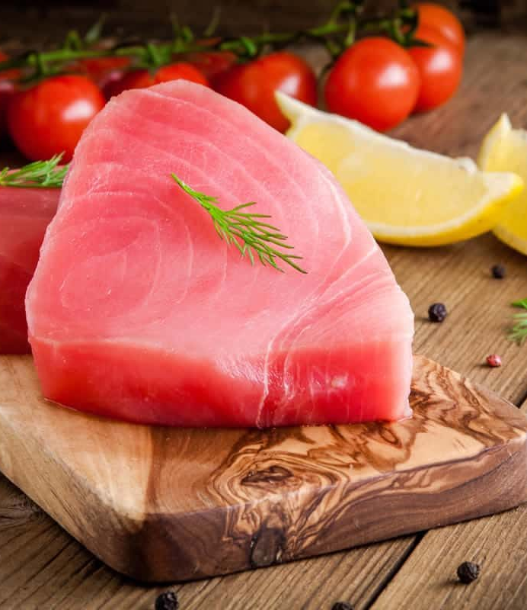
ALL ABOUT TUNA
Tuna is one of the world’s most culturally significant and economically important fish, with roots tracing back to ancient maritime civilizations across the Mediterranean and Pacific. Early societies such as the Phoenicians, Greeks, and Romans documented tuna migrations and developed trap-fishing systems like the tonnara, while Japan and Pacific Island cultures built deep culinary traditions and sophisticated fishing knowledge around this prized species.
By the 20th century, innovations in fishing vessels, freezing, and canning transformed tuna into a global commodity and household staple. Today, most tuna is still harvested from the wild using techniques like purse seining, longlining, and pole-and-line fishing across major ocean regions. This growth in demand has driven significant sustainability efforts, including international stock management and traceability programs that support responsible harvest and long-term resource health.
Alongside wild fisheries, tuna aquaculture has advanced rapidly. Early ranching systems, capturing juveniles and raising them in offshore pens, originated in Japan and expanded to regions like Australia, Mexico, and the Mediterranean. More recently, full-cycle aquaculture, where tuna are bred and raised entirely in captivity, has emerged as a major breakthrough despite the species’ complex biology and high-performance growth needs. Research continues to focus on feed innovation, environmental stewardship, and more efficient farming systems.
Today, tuna supports coastal economies, global supply chains, and culinary traditions around the world. From ceremonial fishing practices in Pacific Island communities to Mediterranean mattanza rituals and the celebrated place of maguro in Japanese cuisine, tuna represents a powerful link between culture, craft, and the ocean. Its story reflects both the richness of marine ecosystems and the shared responsibility to steward them for future generations, making tuna not just an ingredient, but a legacy of the sea.
ACF IOTM
JANUARY 2026
TUNA

Slide 3
HEALTHY INGREDIENT CONTRIBUTION
Tuna is a high-impact nutritional food, delivering substantial portions of daily protein, B12, selenium, and omega-3 fatty acids with relatively few calories. When consumed thoughtfully, it plays a strong role in supporting cardiovascular health, brain function, metabolic efficiency, and overall nutritional adequacy.
Lean Protein: ~20–22 g per serving (≈40% DV) supports muscle repair, satiety, and immunity
Rich Omega-3s: Supports heart health, reduces inflammation, and promotes brain/eye function
Vitamin B12: ~100% DV supports red blood cell production, nerve health, and energy metabolism
Niacin: ~50–60% DV aids energy production and healthy cholesterol metabolism
Vitamin D: Supports bone strength, muscle function, and immune health
High in Selenium: Powerful antioxidant; supports thyroid health and helps offset mercury exposure
Low Saturated Fat: Heart-healthy protein choice with high nutrient density
Moderation: 2–3 servings per week; rotate species for optimal omega-3 benefits and mercury risk
Nutritional Information/Values from USDA FoodData Central
ACF IOTM
JANUARY 2026
TUNA

Slide 4
TYPES AND VARIETIES
Tuna are large, fast-swimming marine fish in the Scombridae family. Several species are commercially important, each with distinct characteristics in flavor, texture, fat content, size, and culinary use.
Major Types & Varieties of Tuna:
Skipjack (Katsuwonus pelamis)
Most widely consumed “light” tuna globally
Mild, slightly stronger than albacore, softer texture
Low to moderate fat content
Highly sustainable in many fisheries
Albacore (Thunnus alalunga)
Known as “white tuna”
Mild, clean, firm, and lighter-colored flesh
Moderate fat content, higher omega-3s
Popular in U.S. retail markets
Yellowfin (Thunnus albacares)
Also known as “ahi”
Clean, rich, meaty; deep pink to red flesh
Moderate fat content
Versatile and widely used in foodservice
Bigeye (Thunnus obesus)
Highly prized for raw preparations
Rich, buttery, and tender
Higher fat content than yellowfin
Careful sourcing due to stock pressures
Bluefin (Thunnus thynnus)
Most valuable and luxurious tuna
Extremely rich, butter, melt-in-the-mouth
Very high fat content, especially toro cuts
Strictly regulated due to overfishing
Longtail (Thunnus tonggol)
Fresh consumption common in Southeast Asia
Stroger flavor with firm flesh
Relatively low fat content
Less common in Western markets
Market Categories: Canned, Shelf-Stable, Fresh, Frozen, Sushi-Grade, Premium
ACF IOTM
JANUARY 2026
TUNA

Slide 5
SELECTING AND STORING
Selecting Tuna:
Fresh
Yellowfin/Bigeye (bright red to pink) and Albacore (pale pink to ivory)
Avoid excessive rainbow sheen or dull discoloration
Flesh should be firm, elastic, and moist; not mushy or slimy
Aroma should be clean, mild, and ocean-like
No gaping, excessive purge (liquid), or dry edges
Tuna should have clear labeling for species, harvest method, and origin
Frozen
Solidly frozen with no soft spots or freezer burn
Minimal ice crystals in packaging
Vacuum-sealed or tightly wrapped
Storing Tuna:
Fresh
Store at 32–36°F (0–2°C), colder than standard refrigeration
Preferred method: Keep tuna on crushed ice (drained) and change ice daily
Wrap tightly in plastic wrap or parchment + plastic
Best used within 24-48 hours
Frozen
Store at 0°F / -18°C or lower
Frozen tuna should be used within 6-8 months for lean and 2-3 months for fatty
Thaw slowly under refrigeration
Never refreeze once thawed
ACF IOTM
JANUARY 2026
TUNA

Slide 6
CULINARY USES
Tuna’s value lies in its species-specific versatility, performing equally well in raw, high-heat, preserved, and convenience-driven applications, making it one of the most adaptable proteins in professional kitchens.
Raw & Minimal Manipulation
Sushi, sashimi, crudo, tartare, poke, carpaccio
Bluefin/Bigeye= richness, fat, mouthfeel
Yellowfin= clean flavor, firm texture
Seared, Grilled, & High Heat
Tataki, rare-seared, binchotan grilling
Maximizes Maillard on exterior
Ideal for yellowfin and albacore loins
Gentle Cooking Methods
Poaching, oil confit, low-temp roasting
Retains moisture and prevents protein tightening
Paired with aromatics, olive oil, herbs, or dashi
Cured, Smoked, & Preserved
Salt curing, cold smoking, bottarga-style
Italian tonno sott’olio, Spanish escabeche
Extends shelf life while intensifying umami
Canned & Processed
Salads, rillettes, croquettes, pasta, spreads
Skipjack for bold flavor
Albacore for clean profile
Global Culinary Inspiration
Niçoise (France)
Maguro don & tekka maki (Japan)
Tuna curry (Sri Lanka / India)
Modern Menu Innovation
Tuna burgers
Tartare cones
Smoked collars
Crudo + fermentation
Cross-utilization of trim for sustainability
ACF IOTM
JANUARY 2026
TUNA

Slide 7
INTERESTING FACTS
Tuna hatch smaller than a grain of rice, yet bluefin can grow over 1,500 pounds
Tuna sit near the top of the marine food chain, rivaled mainly by sharks and marine mammals
Tuna muscles are rich in myoglobin, giving their flesh its deep red color and endurance power
Tuna can swim up to 45–50 mph, making them among the fastest fish in the ocean
Some tuna species migrate thousands of miles each year, crossing entire oceans
Tuna must keep moving to force water over their gills or risk suffocating
Tuna consume 10–25% of their body weight daily to fuel their constant movement
Unlike most fish, tuna can warm their muscles and organs, allowing them to hunt in cold, deep waters
A single bluefin tuna has sold for millions of dollars at Japanese fish auctions
Shelf-stable tuna helped make protein affordable and accessible worldwide in the 20th century
ACF IOTM
JANUARY 2026
TUNA

Slide 8
RECIPE
Sicilian-Style Tuna with Olives & Capers Yield: 4 Servings
Ingredients:
4 6-ounce tuna steaks
1/2 cup extra virgin olive oil, divided
6 cloves garlic, sliced
4 small anchovy fillets or 2 tsp anchovy paste
1/2 tsp red pepper flakes
1/2 cup dry white wine
1 pound cherry tomatoes, halved
3 tbsp capers, rinsed
3/4 cup Sicilian olives pitted, chopped, and rinsed
3 tbsp pine nuts, toasted
1/4 cup flat-leaf Italian parsley, minced
salt and pepper, to taste
Directions:
Heat a large nonstick pan to medium heat with 3 tablespoons of extra virgin olive oil. Pat the tuna steaks dry then season with salt and pepper.
Add the steaks to the pan and sear for 2-3 minutes per side or until browned on the outside but still raw on the inside. Remove the tuna steaks to a plate and tent with foil.
Add the remaining extra virgin olive oil to the pan along with the garlic and anchovies. Break up the anchovies with a wooden spoon and continue to sauté until the garlic is golden.
Add the red pepper flakes and cook for 30 seconds. Add the white wine and turn the heat to high and cook for 1 minute. Add the tomatoes, capers, and olives and bring the sauce to a simmer.
Once the sauce starts to thicken a bit (2-3 minutes) turn the heat to a low simmer and add the tuna steaks back to the pan along with the pine nuts. Spoon the sauce on top of the steaks and cook until your liking (125-130°F for medium-rare or 145-150°F for well done).
Turn off the heat and mix in the parsley. Taste test the sauce and season with salt and pepper if required. There will be enough sauce for roughly a half pound of pasta or serve with crusty bread. Enjoy!
ACF IOTM
JANUARY 2026
TUNA

Slide 9
QUIZ
After you read through this month’s Ingredient of the Month, take this quiz to test your knowledge. In order to earn continuing education hours (CEHs) from the American Culinary Federation (ACF), the test must be completed through the ACF’s Online Learning Center. Seventy-five percent accuracy is required to earn one hour of continuing education credits toward professional certification.
ACF IOTM
JANUARY 2026
TUNA

Slide 10
QUIZ
Question #1
Tuna fishing traditions can be traced back to ancient Mediterranean and Pacific cultures.
True
False
ACF IOTM
JANUARY 2026
TUNA

Slide 11
QUIZ
Question #2
Which fishing methods are commonly used to harvest wild tuna today?
Bottom trawling and dredging
Spearfishing and net casting
Purse seining and longlining
Hand harvesting and reef trapping
ACF IOTM
JANUARY 2026
TUNA

Slide 12
QUIZ
Question #3
Which nutrient in tuna most directly supports cardiovascular and brain health?
Saturated fat
Omega-3 fatty acids
Vitamin C
Calcium
ACF IOTM
JANUARY 2026
TUNA

Slide 13
QUIZ
Question #4
Tuna provides a high level of protein while remaining relatively low in calories.
True
False
ACF IOTM
JANUARY 2026
TUNA

Slide 14
QUIZ
Question #5
Which species is also known as “ahi” and is versatile in foodservice applications?
Yellowfin
Skipjack
Bluefin
Longtail
ACF IOTM
JANUARY 2026
TUNA

Slide 15
QUIZ
Question #6
Which tuna is highly prized for raw preparations and has a rich, buttery, tender texture?
Skipjack
Bigeye
Albacore
Longtail
ACF IOTM
JANUARY 2026
TUNA

Slide 16
QUIZ
Question #7
Excessive purge or liquid in fresh tuna is a sign of good quality.
True
False
ACF IOTM
JANUARY 2026
TUNA

Slide 17
QUIZ
Question #8
What is the recommended storage temperature for fresh tuna?
40–45°F (4–7°C)
32–36°F (0–2°C)
28–30°F (-2 to -1°C)
0°F (-18°C)
ACF IOTM
JANUARY 2026
TUNA

Slide 18
QUIZ
Question #9
Cross-utilization of tuna trim in modern kitchens is primarily aimed at:
Reducing cooking time
Enhancing visual presentation
Supporting sustainability
Making it suitable only for raw applications
ACF IOTM
JANUARY 2026
TUNA

Slide 19
QUIZ
Question #10
How much of their body weight do tuna consume daily to fuel constant movement?
1-5%
5-10%
10-25%
25-40%
ACF IOTM
JANUARY 2026
TUNA

Slide 20
JOIN US NEXT MONTH!
Stay tuned for the next ACF Ingredient of the Month! Be sure to visit the Online Learning Center (OLC) to download a copy of each month’s ingredient presentation. Don’t forget to take the official IOTM quiz through the OLC to earn one hour of continuing education credits toward professional certification.
For more information:
www.acfchefs.org
www.acfchefs.org/olc
www.acfchefs.org/iotm
ACF IOTM
JANUARY 2026
TUNA

