Slide 2
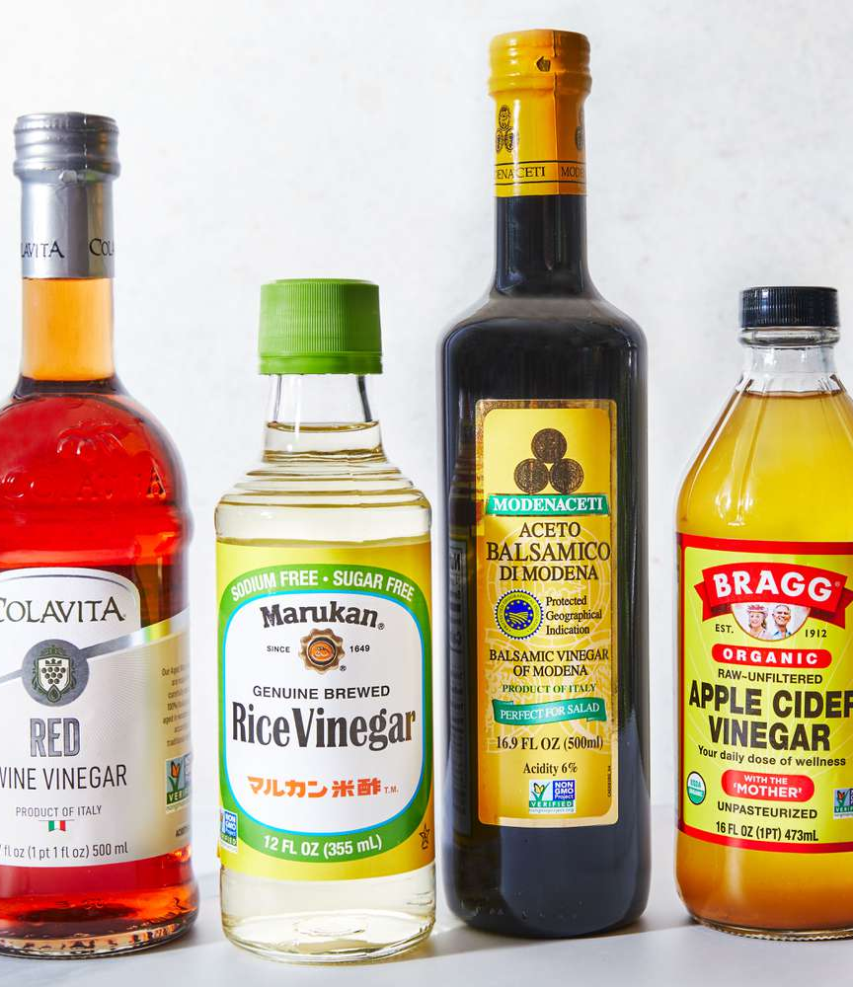
ALL ABOUT VINEGAR
Deriving its name from the French term vin aigre, meaning “sour wine,” vinegar is a sour-tasting liquid produced through fermentation of ethanol by acetic acid bacteria. Vinegar’s culinary use dates back to ancient civilizations with the Babylonians using it as early as 5000 BCE for both flavoring and preserving food. Ancient Egyptians, Greeks, and Romans also valued vinegar not only for its taste but also for its perceived medicinal qualities. Roman soldiers commonly drank a mix of vinegar and water called posca, while the Chinese were producing rice vinegar as far back as 1200 BCE.
Vinegar is produced in two main steps: alcoholic fermentation and acetic acid fermentation. First, a sugar- or starch-based substance (such as grapes, apples, rice, or grains) is fermented by yeast to produce ethanol. Then, specific bacteria, usually Acetobacter, oxidize the ethanol into acetic acid in the presence of oxygen.
Traditional production methods, such as the Orléans process developed in France, involve slowly aging vinegar in wooden barrels, which adds depth and complexity to its flavor. Modern industrial methods, like the submerged fermentation process, use stainless steel tanks and aeration to speed up production dramatically.
Beyond flavor, vinegar also affects the texture and chemistry of food. It can denature proteins, tenderize meat, brighten vegetables, and stabilize emulsions. Its acidic pH makes it useful in baking (as a leavening acid in combination with baking soda) and essential in canning and preserving. In short, vinegar is both a historic and indispensable ingredient in the global culinary landscape, valued as much for its versatility as for its sharp, defining taste.
ACF IOTM
AUGUST 2025
VINEGAR

Slide 3
HEALTHY INGREDIENT CONTRIBUTION
While vinegar isn't nutrient-dense in the traditional sense, vinegar offers several functional health benefits that go beyond the flavor they add to a dish:
Aids Digestion & Gut Health
  Naturally fermented vinegars can contain probiotics, especially if unfiltered, which support gut microbiota and digestive health
Supports Blood Sugar Control
  Vinegar has been shown to help reduce post-meal blood sugar spikes by improving insulin sensitivity and slowing the absorption of carbohydrates
Enhances Satiety
  Adding vinegar to meals may promote a sense of fullness potentially aiding in appetite control and weight management
Mineral Absorption
  Acetic acid in vinegar may help the body better absorb minerals such as calcium, magnesium, and iron from plant-based foods
Heart Health
  Studies suggest regular consumption of vinegar may help lower cholesterol and triglyceride levels thus contributing to cardiovascular health
Antimicrobial Properties
  Vinegar’s natural acidity makes it effective in inhibiting growth of harmful bacterial both in food and in the digestive tract
Nutritional Information/Values from USDA FoodData Central
ACF IOTM
AUGUST 2025
VINEGAR

Slide 4
TYPES AND VARIETIES
Born from the natural fermentation of sugars into acetic acid, vinegar offers a wide spectrum of flavors from sharp and tangy to mellow and sweet. The type of vinegar used can dramatically influence the taste and character of a dish, making it essential to understand the unique properties of each variety.
Wine-Based Vinegar
Red Wine Vinegar
  Bold, tangy, rich
White Wine Vinegar
  Light, delicate
Champagne Vinegar
  Subtle, crisp
Fruit-Based Vinegar
Apple Cider Vinegar
  Tart, fruity, slightly sweet
Balsamic Vinegar
  Thick, sweet, complex
Fruit Vinegar (Examples: Pear, Raspberry, Fig)
  Infused or made directly from fruit
Grain-Based Vinegar
Rice Vinegar (Varieties: Seasoned, Unseasoned)
  Mild, slightly sweet
Malt Vinegar
  Rich, toasty
Alcohol-Based Vinegars
White Distilled Vinegar
  Acidic, sharp
Spirit Vinegar
  Higher acidity, sharp
Specialty Vinegars
Sherry Vinegar
  Aged, complex, nutty
Coconut Vinegar
  Tangy, earthy
Palm Vinegar
  Nutty, earthy, mildly acidic
Cane Vinegar
  Mild, slightly sweet
Beer Vinegar
  Malty, tangy
Infused Vinegar
  Examples: garlic, chili, tarragon, citrus peel
ACF IOTM
AUGUST 2025
VINEGAR

Slide 5
SELECTING AND STORING
Selecting Vinegar:
Flavor Profile
  Depth & Sweetness: Balsamic, Fruit, or Sherry Vinegar
  Lighter Acidity: White Wine, Rice, or Apple Cider Vinegar
  Pickling or Neutral Acidity: Distilled White Vinegar
Fermentation Type:
  Additional probiotic and nutritional benefits
  Available as raw, unfiltered or naturally fermented
  Sometimes includes “mother”
Quality Indicators
  Aged vinegars like traditional balsamic or sherry have richer flavor
  Often include a protected designation (e.g., DOP)
  Avoid flavored vinegars with excessive additives or artificial coloring
Storing Vinegar:
Keep in a Cool, Dark Place
  Vinegar is highly shelf-stable due to its acidity but should be stored away from heat and sunlight to preserve aroma and taste
Use Airtight Containers
  Glass bottles are best with the cap kept tightly closed to prevent oxidation and contamination
Refrigeration Not Needed
  Most vinegars, except some house made or infused varieties, do not require refrigeration even after opening
Shelf Life
  Most vinegars have virtually an indefinite shelf life but should be used within 2-3 years for peak flavor
  Raw vinegars with a “mother” may continue fermenting and form harmless sediment over time
  If vinegar becomes unusually cloudy, smells off, or develops mold, it is best to discard it
ACF IOTM
AUGUST 2025
VINEGAR

Slide 6
CULINARY USES
Vinegar is one of the most versatile ingredients in the kitchen, valued not only for its sharp, bright flavor but also for its preserving, balancing, and tenderizing properties. Below are the primary culinary uses of vinegar:
Flavor Enhancer
Brightens & Balances Flavors
Cuts Richness & Boosts Umami
Salad Dressing & Vinaigrettes
Balsamic Vinegar: Sweetness & Depth
Red or White Wine Vinegar: Sharp Tang
Rice Vinegar: Mild, Slightly Sweet Flavor
Pickling & Preserving
Acidity Prevents Bacterial Growth
Quick & Traditional Fermented Pickles
Chutneys & Relishes
Ceviche & Escabeche
Marinades & Tenderizing
Breaks Down Tough Fibers & Imparts Flavor
Rice Seasoning
Flavors Rice & Preserves Texture
Braising & Deglazing
Cuts Heaviness & Balances Slow-Cooked, Rich Flavors
Creates Sweet-Sour Depth
Baking
Natural Leavening Booster
Used in Eggless Cakes & Fluffy Quick Breads
Dairy Substitution for Buttermilk
Fresh Cheese Curdling & Production
Sauces & Bases
Balsamic Reductions & Vinegar Gastriques
Pan Sauces for Meat & Vegetables
Seafood Mignonettes
Beverages
Refreshing & Probiotic Rich
Health Drinks & Detox Tonics
NA Beverage Concoctions
ACF IOTM
AUGUST 2025
VINEGAR

Slide 7
INTERESTING FACTS
The transformation of wine to vinegar was likely one of the earliest human encounters with fermentation long before people understood microbes or chemistry
In the wine world, the presence of acetic acid bacteria is considered disastrous and can turn an entire vintage into vinegar
In 18th-century Europe, failed beer batches were often turned into malt vinegar rather than being discarded
According to legend, Cleopatra dissolved a priceless pearl in vinegar and drank it, proving she could host the most expensive meal in history
Similar to Champagne, some varieties of vinegar carry a “Protected Designation of Origin” status
Vinegar is made on every continent on the planet (except Antarctica) and a whopping 7 million tons is produced each year
The global vinegar market was valued at over $1.3 billion USD in 2023
Using submerged fermentation tanks with controlled aeration, modern vinegar factories can produce batches of vinegar in as little as 24–48 hours
In certain regions like the Caribbean, spicy vinegar or pickled pepper vinegar is drizzled over pizza for heat and acidity
ACF IOTM
AUGUST 2025
VINEGAR

Slide 8
RECIPE
Filipino Chicken Adobo
Yield: 4-6 Servings
Ingredients:
3 Lbs. Chicken Thighs, Bone-In, Skin-On
1/2 C. Cane Vinegar
1/3 C. Filipino-Style Soy Sauce
6 Cloves Garlic, Smashed
2 Bay Leaves
1 Tsp. Whole Black Peppercorns
2 Tbsp. Vegetable Oil
1 Medium Onion, Sliced
1/2 C. Water
2 Tsp. Brown Sugar
Cooked Jasmine Rice, For Serving (optional)
Green Onions, Sliced, For Garnish (optional)
Red Chiles, Sliced, For Garnish (optional)
Directions:
In a large bowl, combine the chicken, vinegar, soy sauce, garlic, bay leaves, and peppercorns. Let marinate for at least 30 minutes or up to overnight in the refrigerator.
Remove the chicken from the marinated and reserve the liquid.
Heat vegetable oil in a deep skillet over medium heat.
Sear the chicken skin-side down until golden brown, about 4-5 minutes per side. Work in batches if needed. Remove the chicken from the pan.
Remove excess oil, leaving about 1 tablespoon. Add sliced onions and sauté for 2-3 minutes until softened. Return the chicken to the pan.
Pour in reserved marinade and add the water and brown sugar. Bring to a boil and then reduce to a simmer. Cover and cook for 30-35 minutes, turning chicken occasionally, until tender.
Remove the lid and simmer uncovered for 10-15 additional minutes or until the sauce thickens and slightly glazes the chicken. Excess fat can be skimmed if desired.
Serve immediately over steamed jasmine rice and garnish with sliced green onions and chiles if desired.
ACF IOTM
AUGUST 2025
VINEGAR

Slide 9
QUIZ
After you read through this month’s Ingredient of the Month, take this quiz to test your knowledge. In order to earn continuing education hours (CEHs) from the American Culinary Federation (ACF), the test must be completed through the ACF’s Online Learning Center. Seventy-five percent accuracy is required to earn one hour of continuing education credits toward professional certification.
ACF IOTM
AUGUST 2025
VINEGAR

Slide 10
QUIZ
Question #1
Which bacteria is primarily responsible for converting ethanol into the acetic acid found in vinegar?
Lactobacillus
Streptococcus
Acetobacter
Bifidobacterium
ACF IOTM
AUGUST 2025
VINEGAR

Slide 11
QUIZ
Question #2
Which traditional vinegar-making method involves aging in wooden barrels?
Orléans Process
Bordeaux Cascade Method
Open Vat Process
Italian Balsamic Method
ACF IOTM
AUGUST 2025
VINEGAR

Slide 12
QUIZ
Question #3
What potential cardiovascular benefit has been associated with regular vinegar consumption?
Increased heart rate
Lower cholesterol and triglycerides
Thickened arterial walls
Higher sodium levels
ACF IOTM
AUGUST 2025
VINEGAR

Slide 13
QUIZ
Question #4
Acetic acid can help improve absorption of minerals like iron and calcium from plant foods.
True
False
ACF IOTM
AUGUST 2025
VINEGAR

Slide 14
QUIZ
Question #5
You’re developing a pan sauce in the kitchen. Which vinegar would best enhance the flavor with its aged, complex, and nutty profile?
Sherry vinegar
Seasoned rice vinegar
Champagne vinegar
Spirit vinegar
ACF IOTM
AUGUST 2025
VINEGAR

Slide 15
QUIZ
Question #6
Spirit vinegar typically has lower acidity than white distilled vinegar.
True
False
ACF IOTM
AUGUST 2025
VINEGAR

Slide 16
QUIZ
Question #7
What should you do if vinegar becomes unusually cloudy, smells off, or develops mold?
Shake well and continue use
Boil and reuse
Add vinegar to dilute
Discard it
ACF IOTM
AUGUST 2025
VINEGAR

Slide 17
QUIZ
Question #8
In addition to enhancing flavor, what key culinary function does vinegar serve when used in marinades?
Breaks down fibers
Acts as a thickener
Neutralizes sodium
Enhances color
ACF IOTM
AUGUST 2025
VINEGAR

Slide 18
QUIZ
Question #9
Which of the following accurately reflects global vinegar production and its market value in 2023?
700 tons; $130 million
7,000 tons; $300 million
70,000 tons; $700 million
7,000,000 tons; $1.3 billion
ACF IOTM
AUGUST 2025
VINEGAR

Slide 19
QUIZ
Question #10
What is the primary acidic ingredient used in the marinade for Filipino Chicken Adobo?
Lemon juice
White distilled vinegar
Cane vinegar
Apple cider vinegar
ACF IOTM
AUGUST 2025
VINEGAR

Slide 20
JOIN US NEXT MONTH!
Stay tuned for the next ACF Ingredient of the Month! Be sure to visit the Online Learning Center (OLC) to download a copy of each month’s ingredient presentation. Don’t forget to take the official IOTM quiz through the OLC to earn one hour of continuing education credits toward professional certification.
For more information:
www.acfchefs.org
www.acfchefs.org/olc
www.acfchefs.org/iotm
ACF IOTM
AUGUST 2025
VINEGAR

